Slide 1

CapStone Project
AWS BigData Professional

Slide 2












Solution Architecture
Crawler
AWS Glue Data Catalog
AWS Glue
Kinesis Data Firehose
Amazon S3
Amazon
Athena
Amazon
QuickSight
Kinesis-enabled app
Kinesis
Data Stream
Amazon EMR

Slide 3
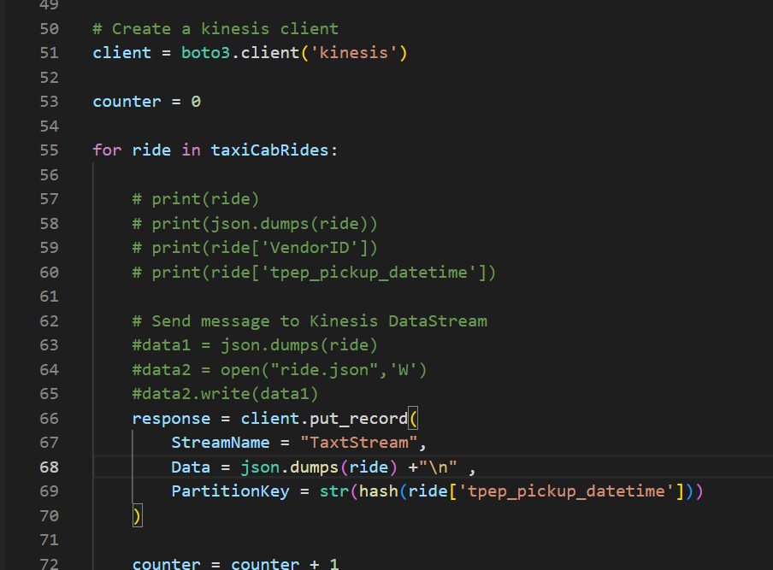
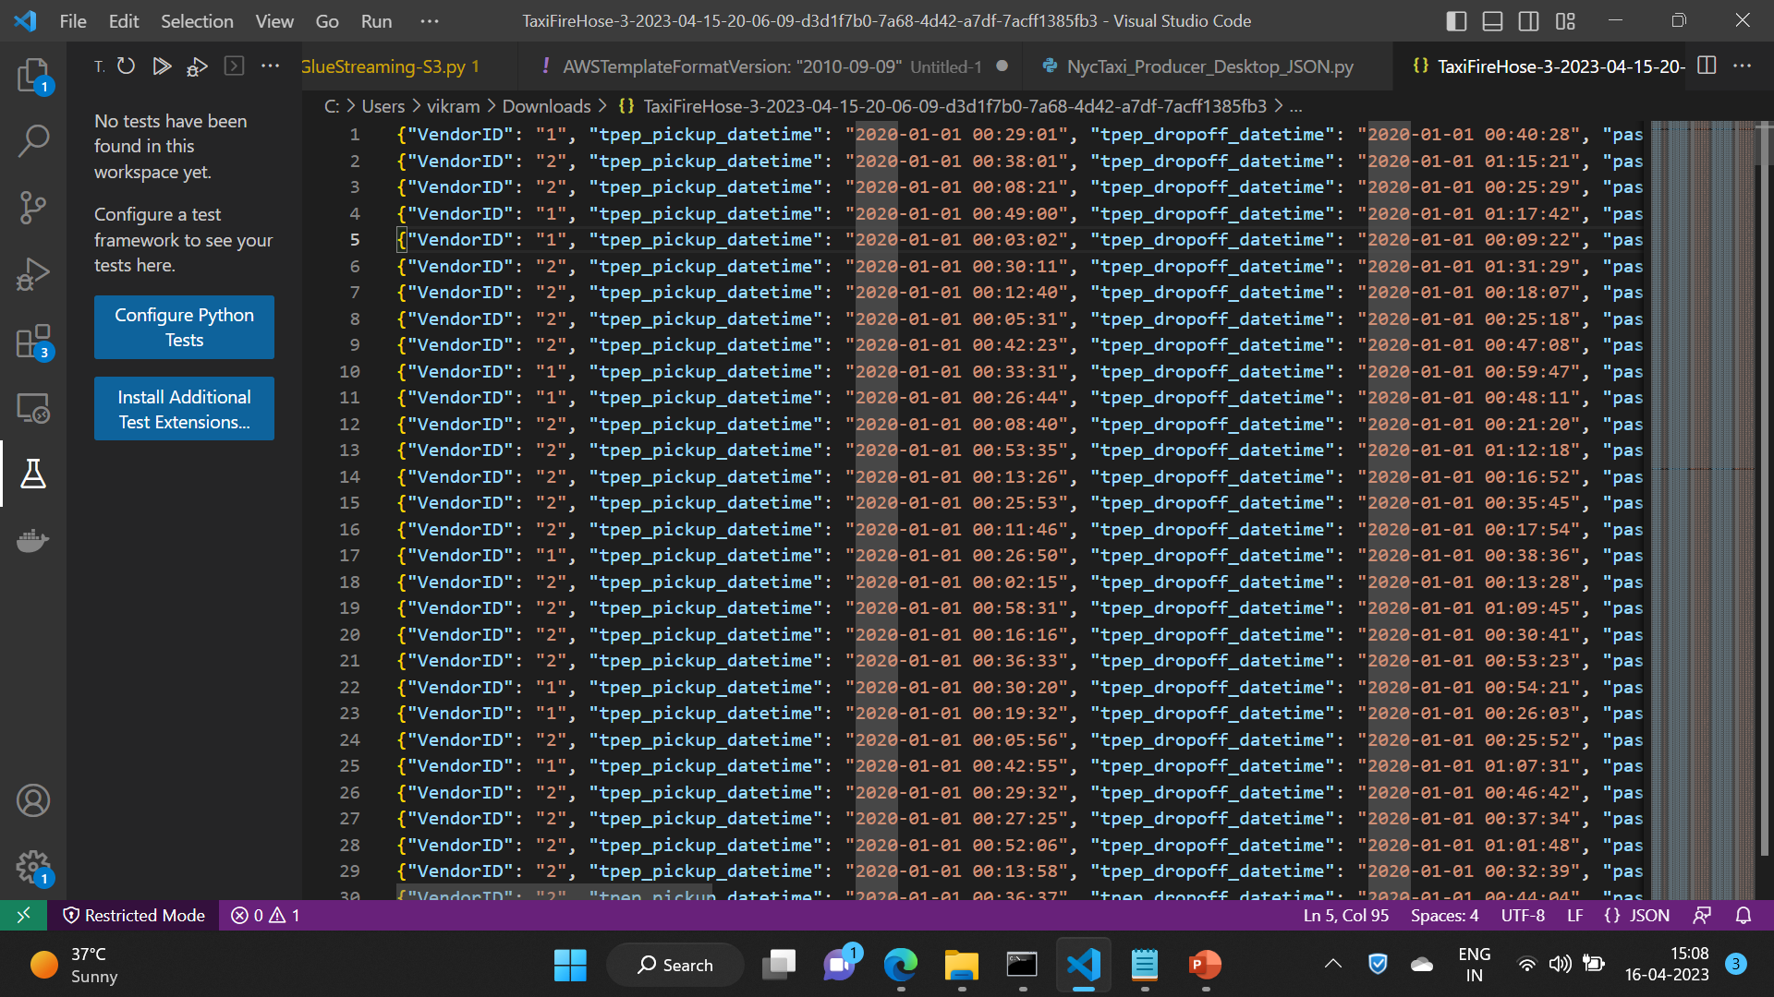
Kinesis Application
Json Data :

Slide 4
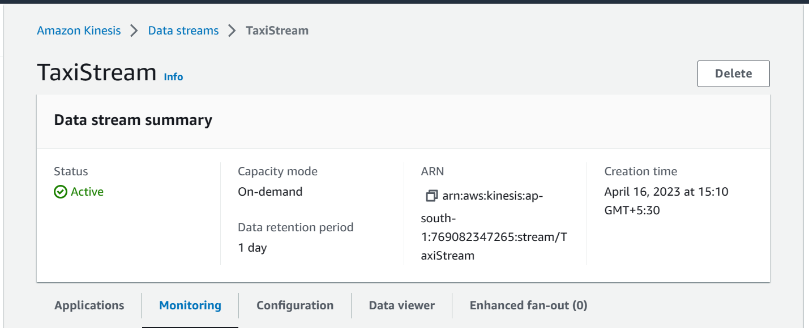
Kinesis Data Stream

Slide 5
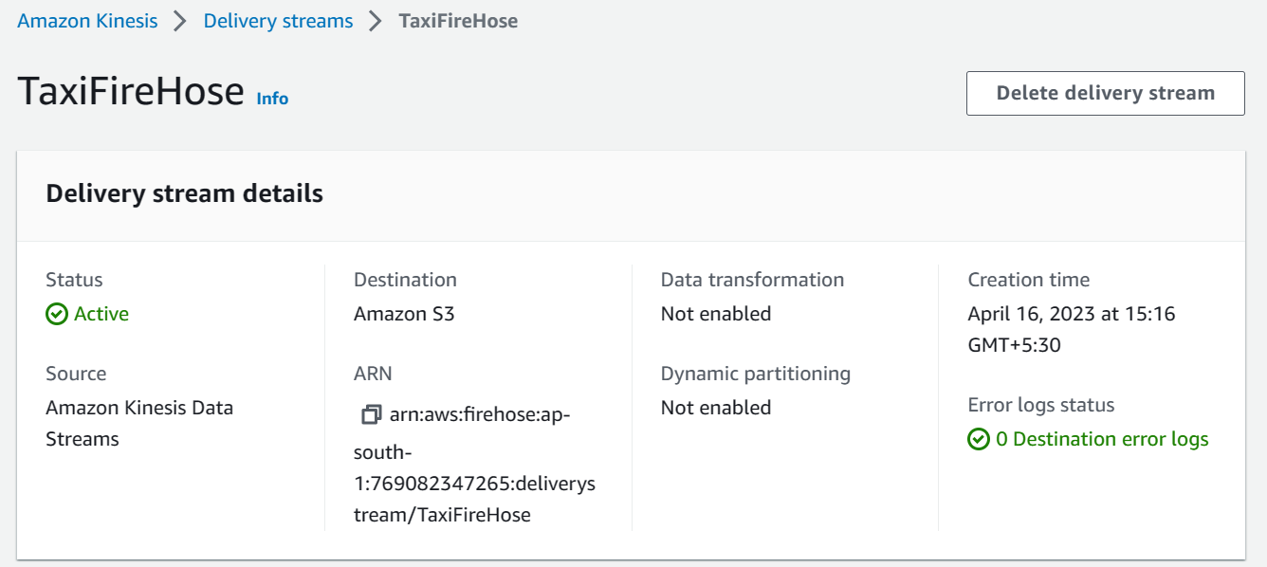
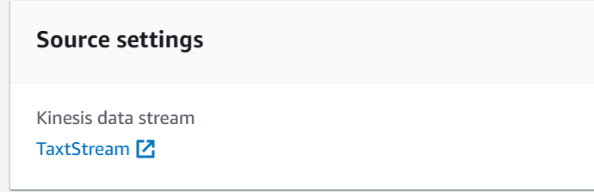
Kinesis Data FireHose

Slide 6
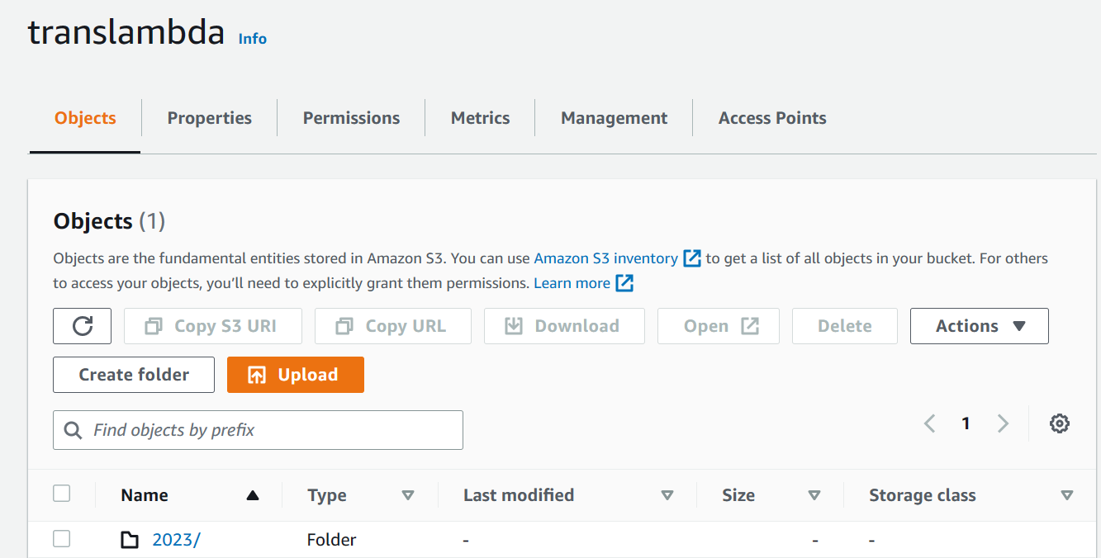
S3 Bucket

Slide 7
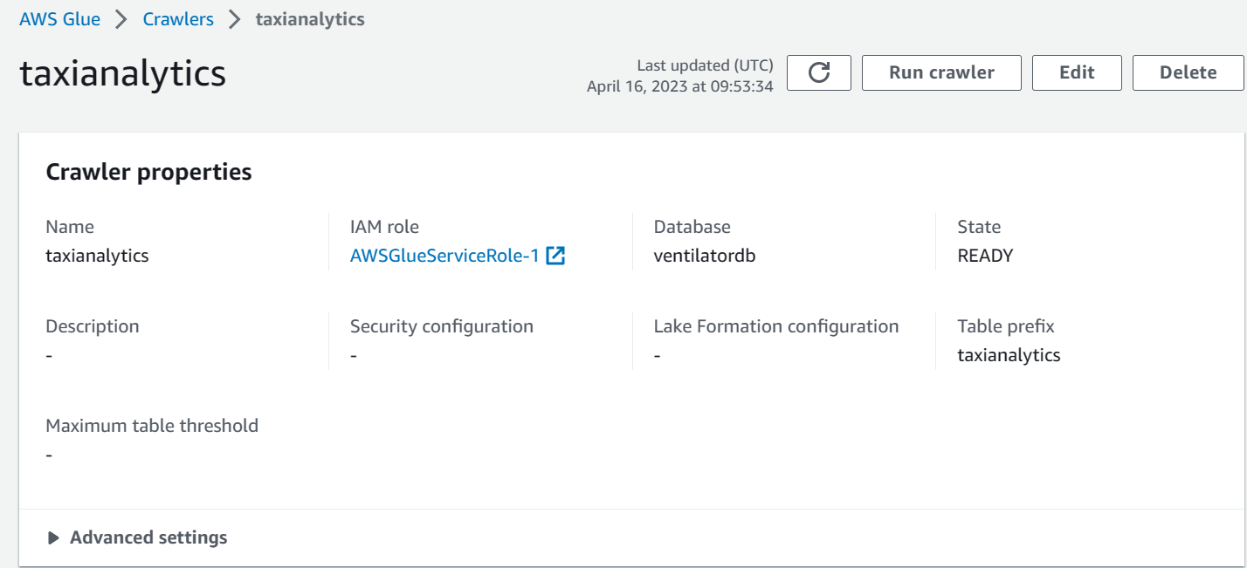
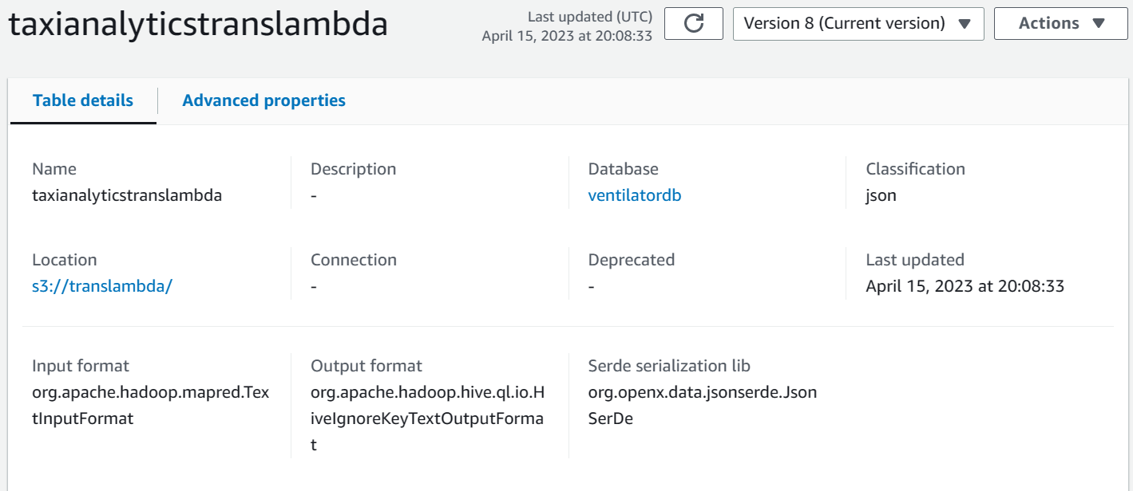
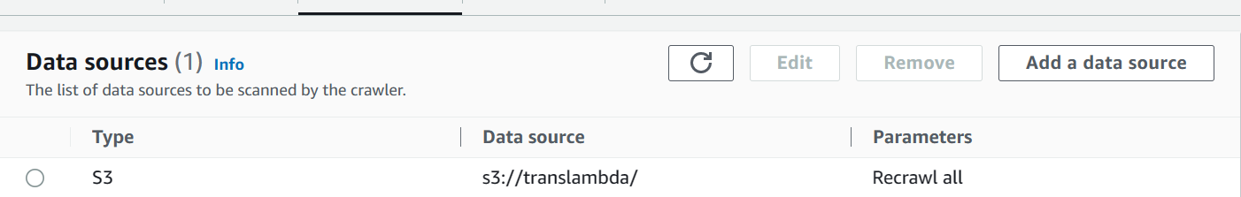
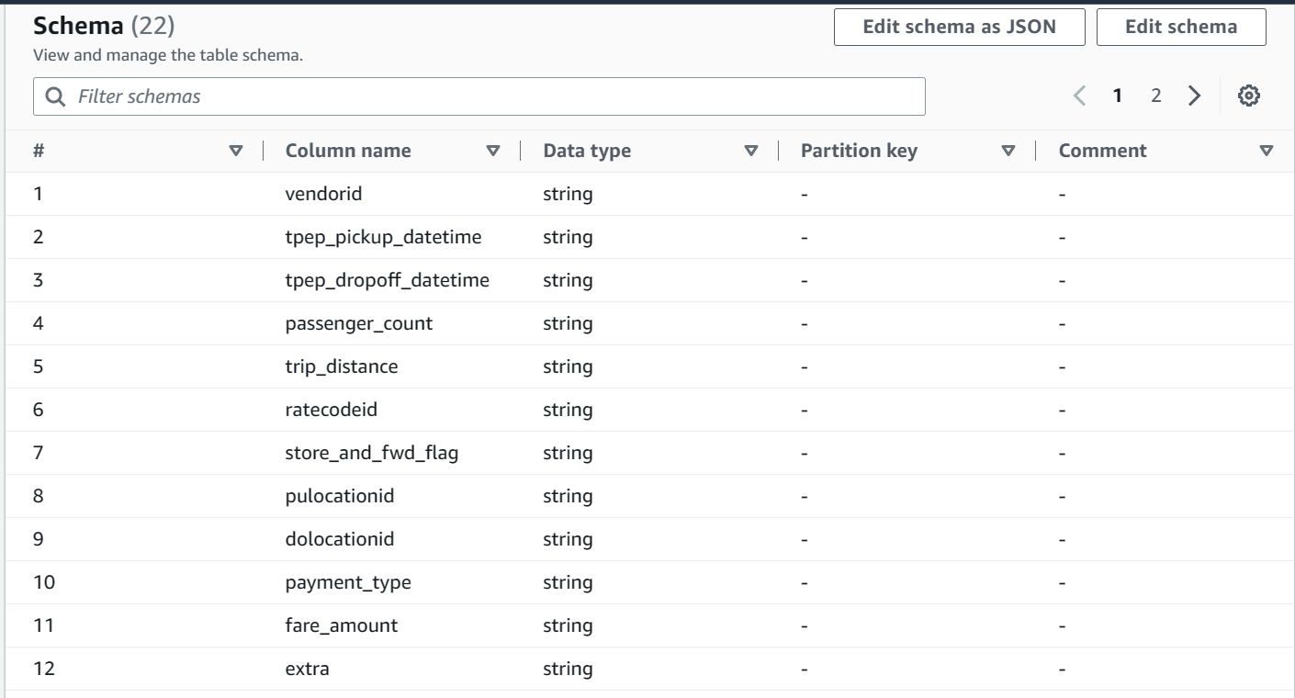
Glue

Slide 8
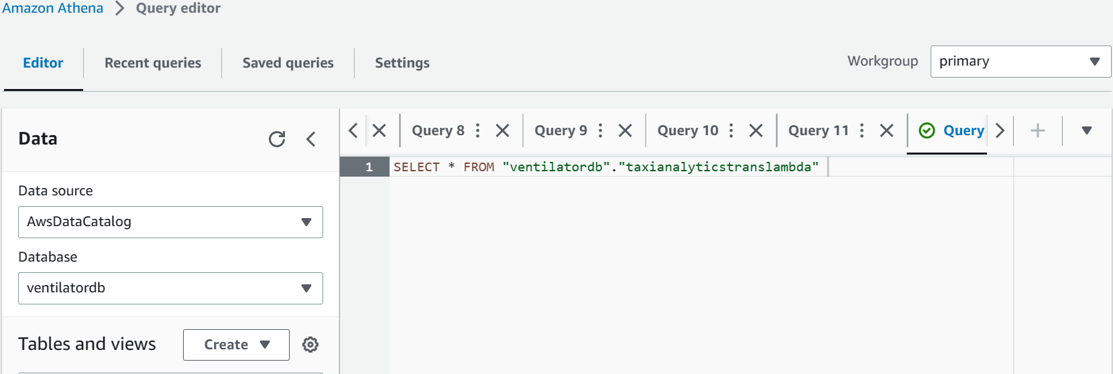
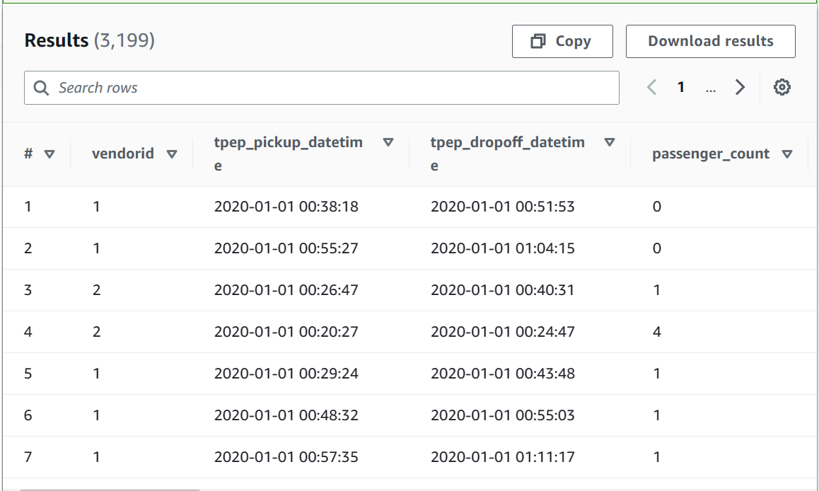
Athena

Slide 9
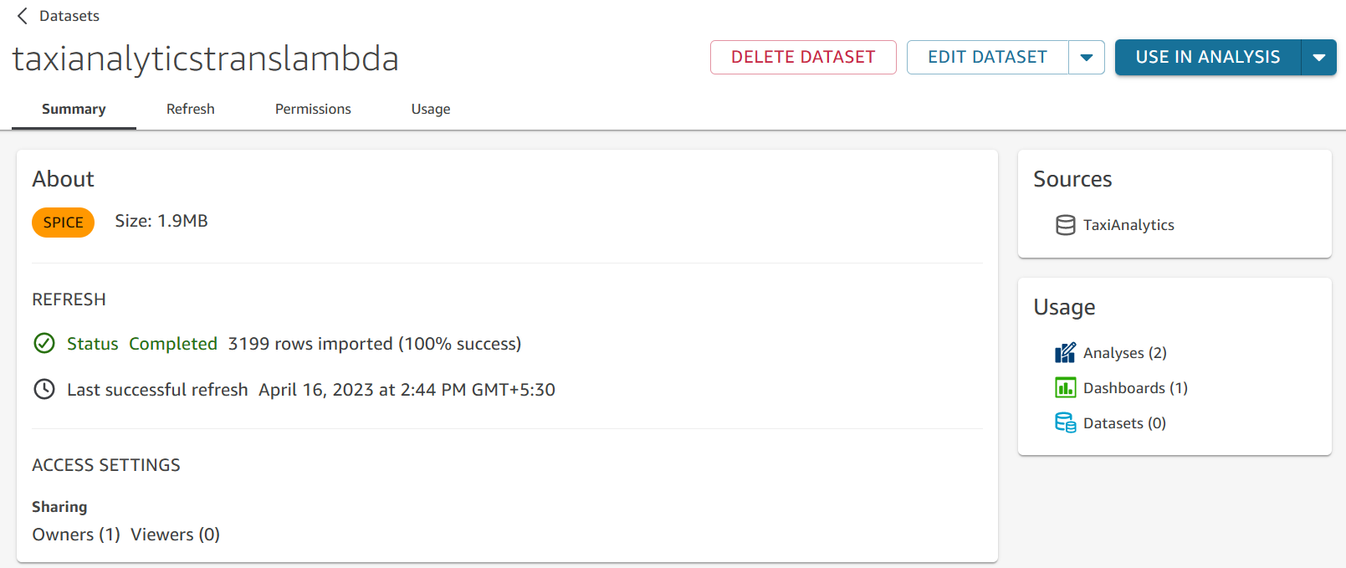
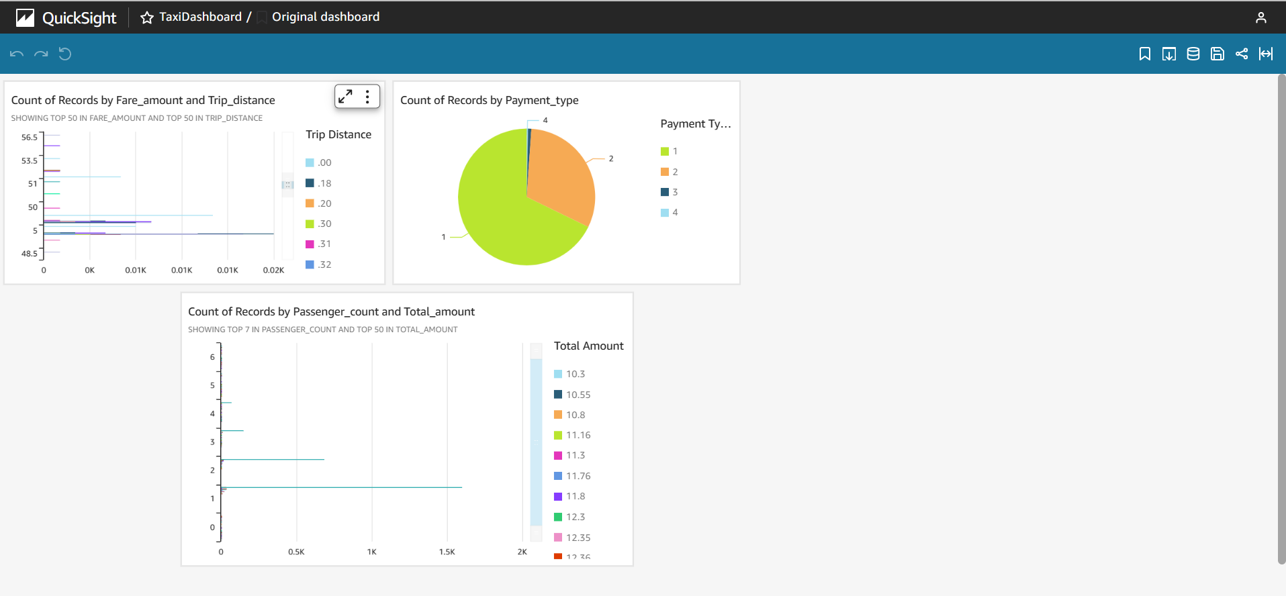
Quick Sight

Slide 10
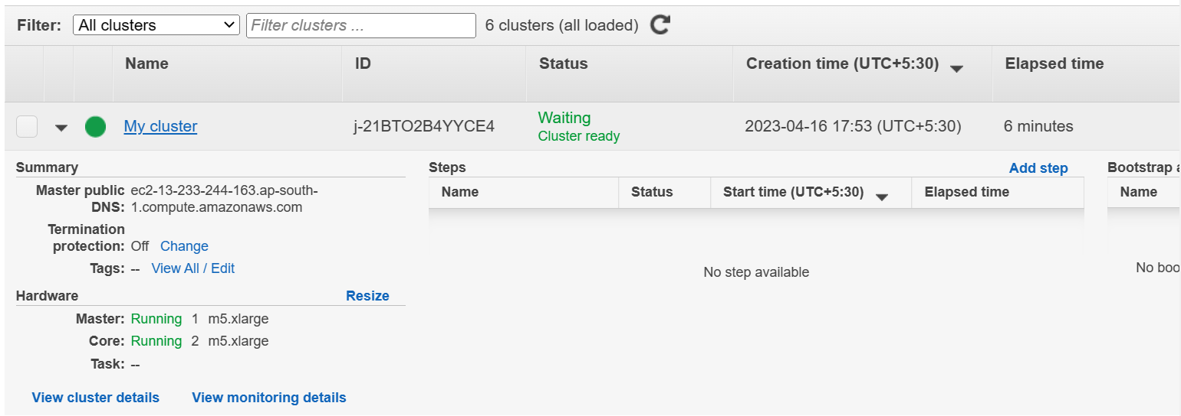
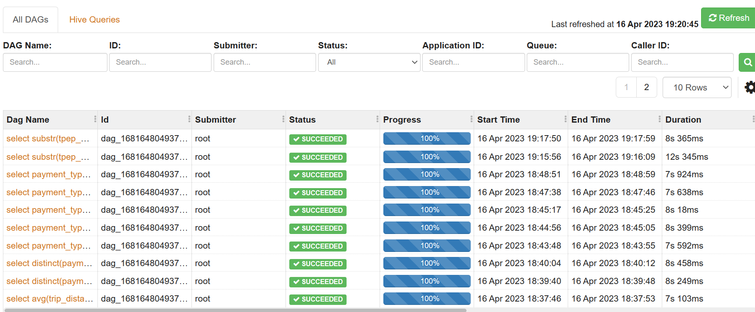
EMR Cluster

Slide 11
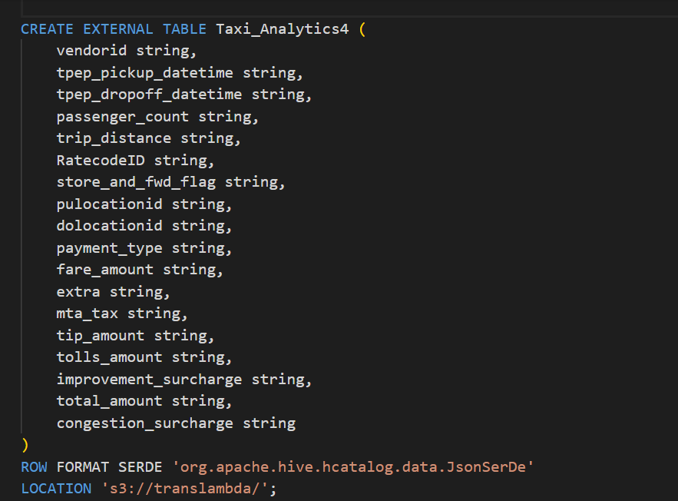
HIVE Table

Slide 12
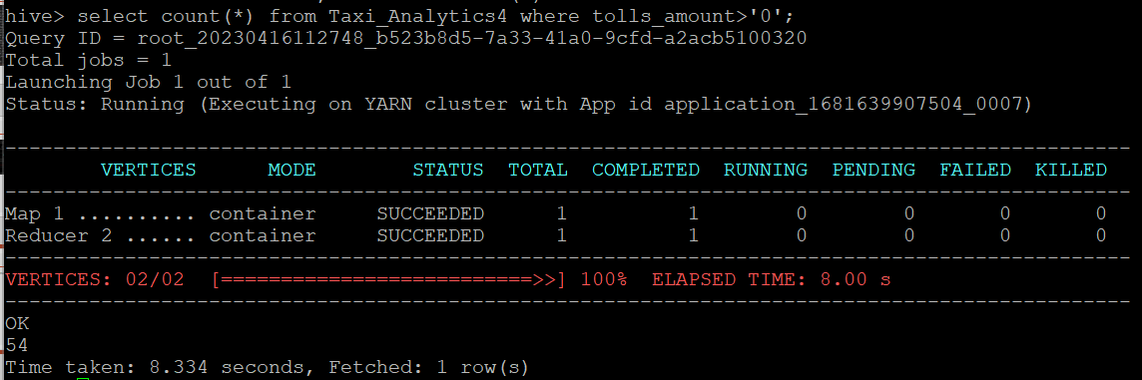
Analytics#1
What is the total number of trips?

Slide 13
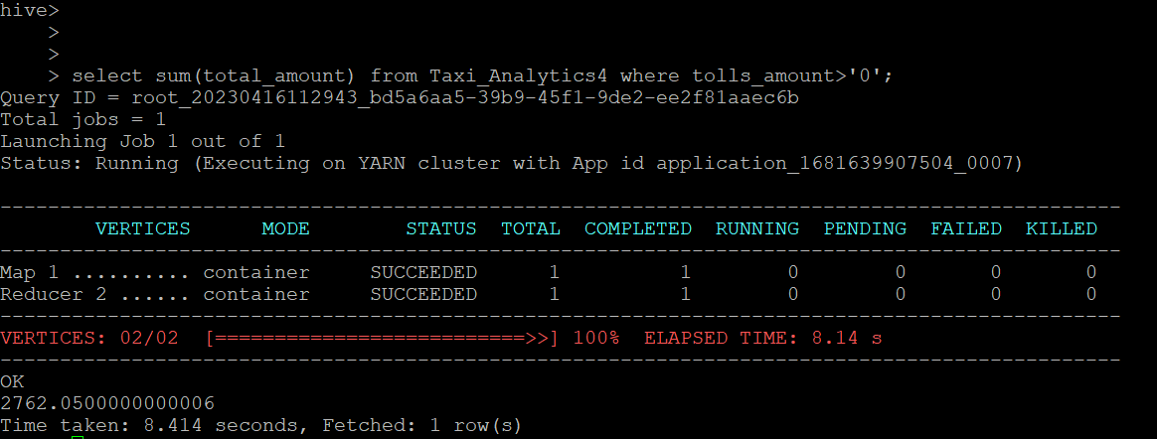
Analytics#2
What is the total revenue generated by all the trips?

Slide 14
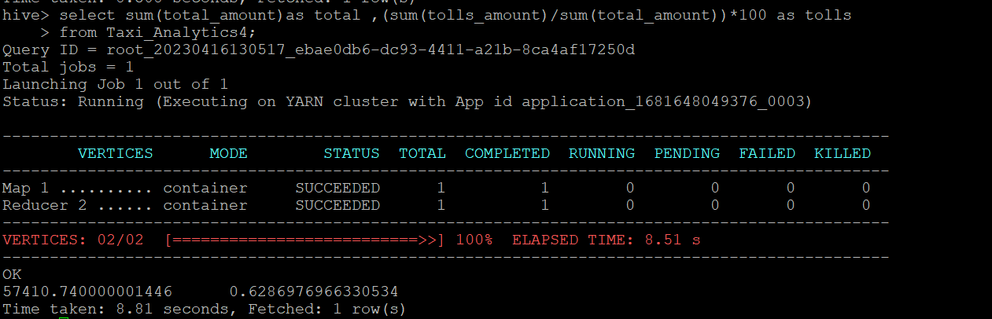
Analytics#3
What fraction of the total is paid for tolls?

Slide 15
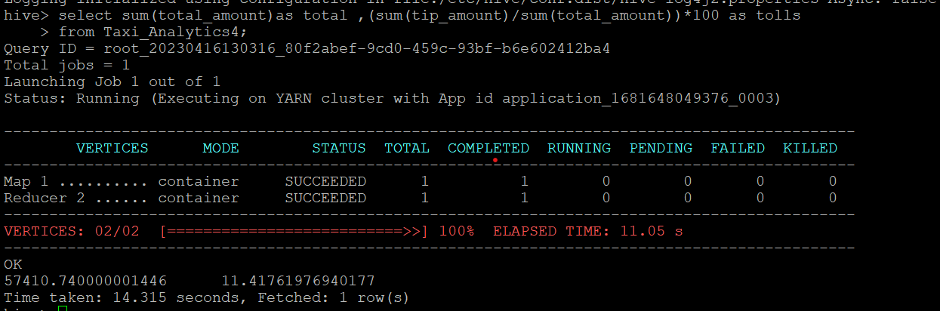
Analytics#5
What fraction of the total is paid as driver tips? (Tips are stored in tip_amount)

Slide 16
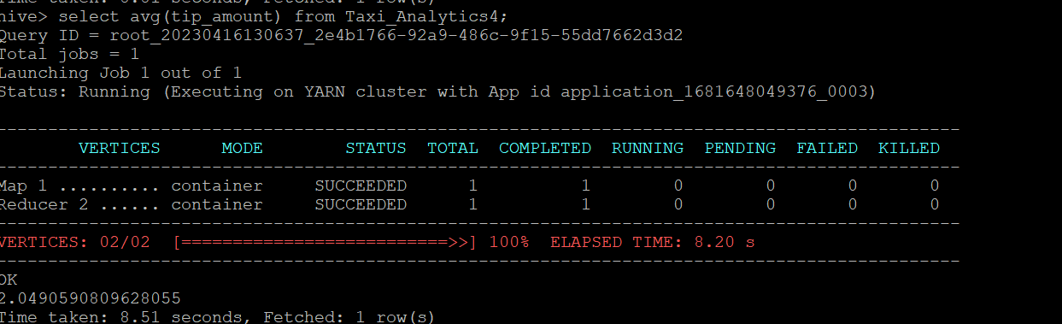
Analytics#6
What is the average trip amount?

Slide 17
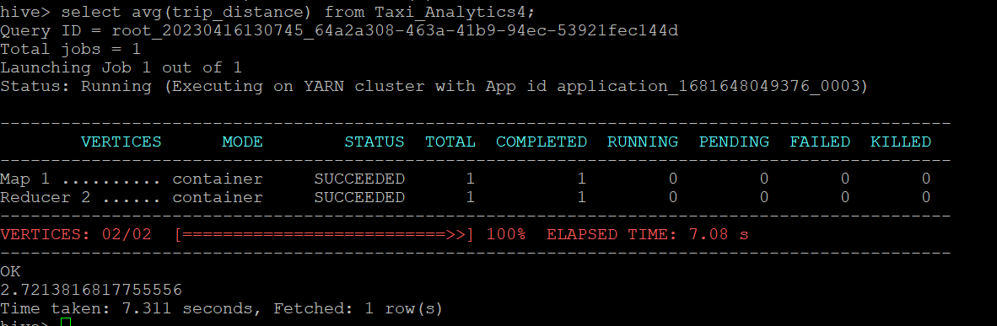
Analytics#7
What is the average distance of the trips?

Slide 18
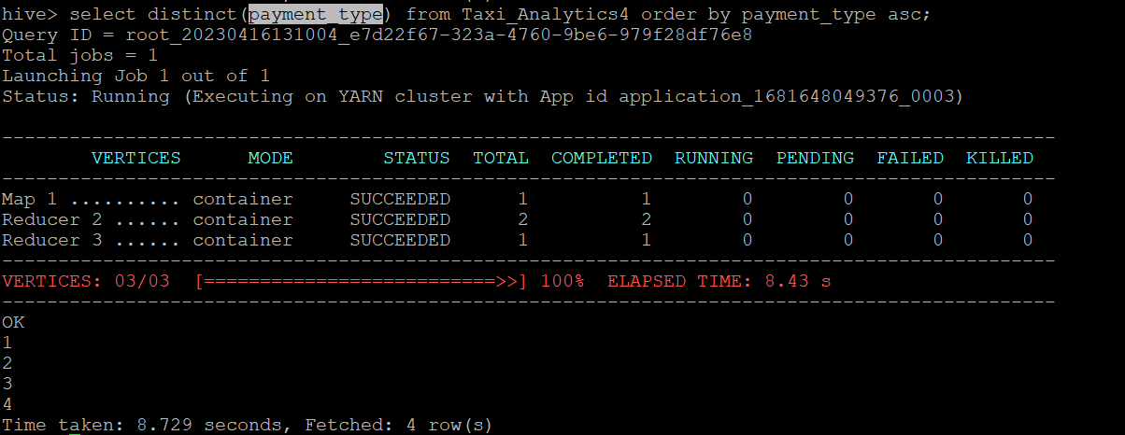
Analytics#8
How many different payment types are used?

Slide 19
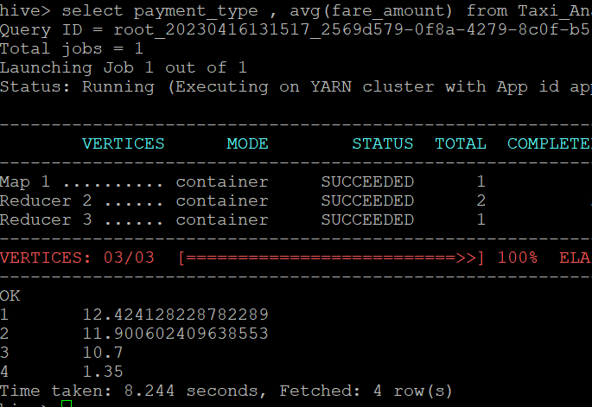
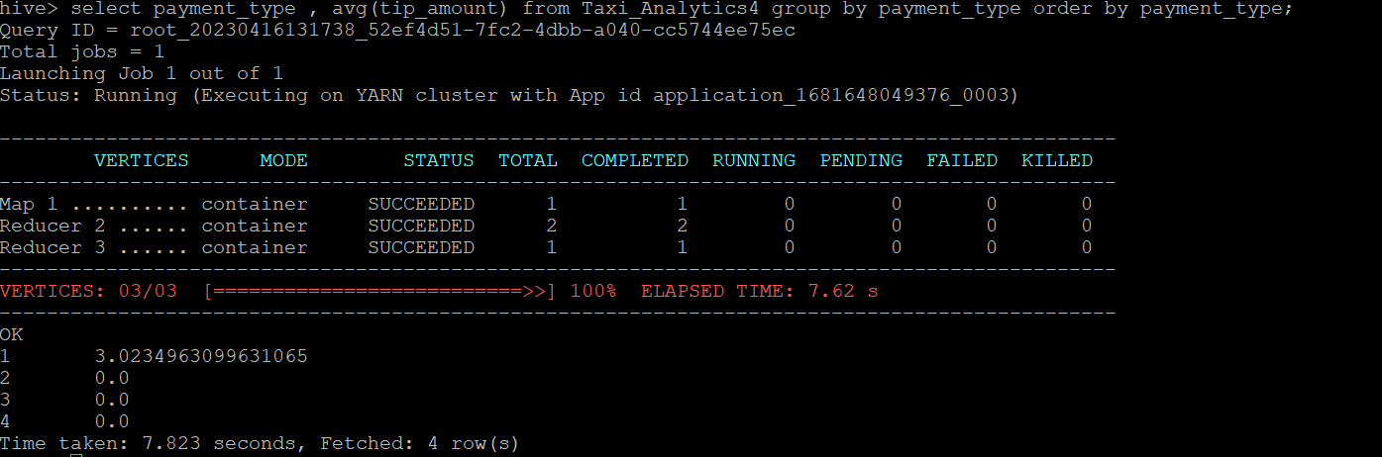
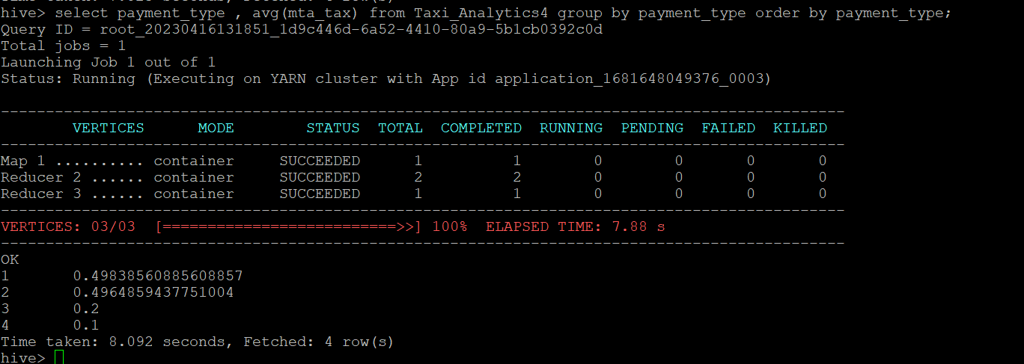
Analytics
For each payment type, display the following details:
● Average fare generated
● Average tip
● Average tax

Slide 20
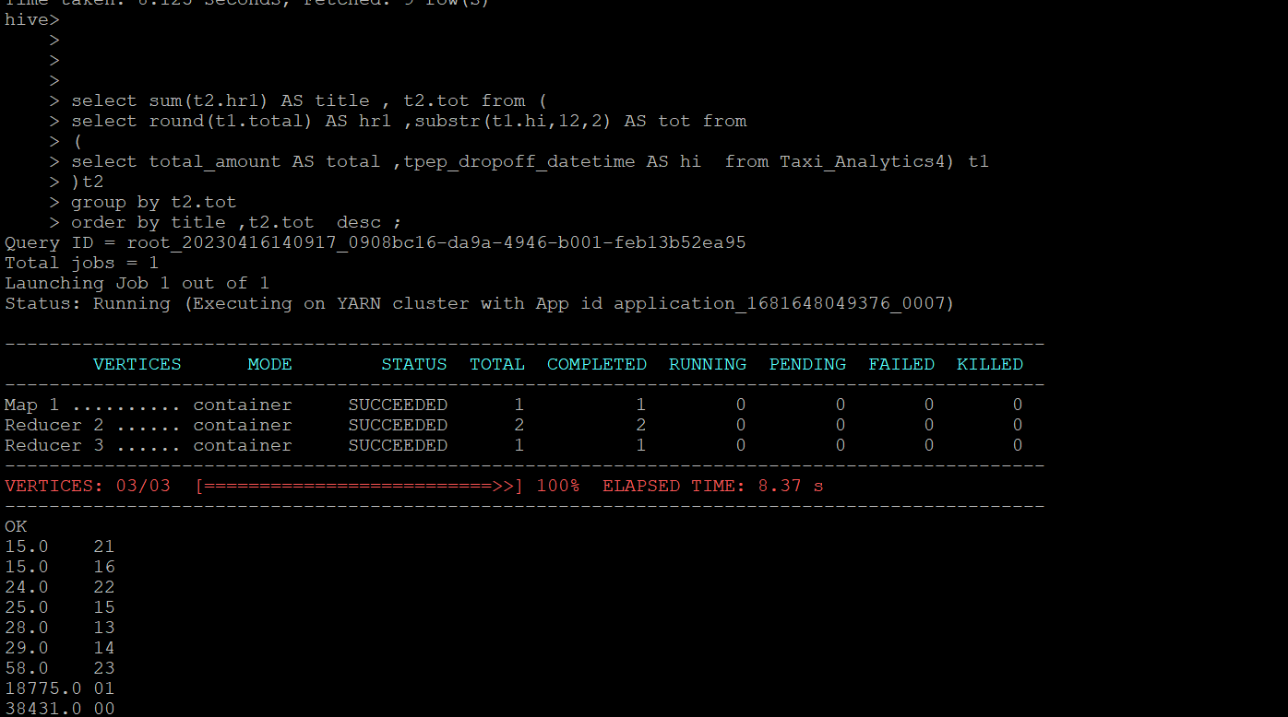
Analytics#1
On average, which hour of the day generates the highest revenue?

